Slide 1

OS -MINI PROJECT
GROUP - 1
GROUP MEMBERS
AYUSHMAAN SINGH JAMWAL
RAKSHIT GUPTA
SIA
SASHAKT

Slide 2
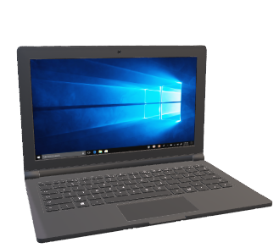
PROJECT TITLE
“Creating a login based Online Test Platform using Linux pattern matching commands and file handling concept. ”

Slide 3

Introduction
These days there are a lot of online test platform which enables students to take test online. They Will typically have a user-interface, backend question bank and evaluation part. They will also support other features like predefined time per question, output reports, etc. The idea of this project is to stimulate such an online test interface using Linux Shell Scripting and commands.

Slide 4
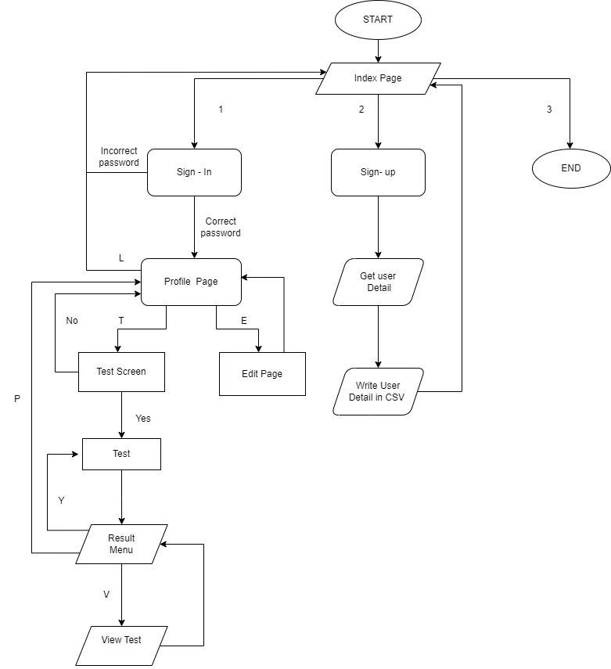
Flowchart Website
FLOWCHART

Slide 5
Algorithm
The student Will be provided 3 options:-
1. Sign-In
2. Sign-Up
3. Exit
The input given by the user will be stored as argument named "input_user_index"
If "$input_user_index == 1", then the user will be directed to the sign_in_page.sh
The user will be asked to enter the email-id and password.These details will be stored in argument "sign_in_email" and "sign_in_password".
If "${email_id_field[i]} == $sign_in_email ${password_field[i]} == $sign_in_password" then user will be directed to profile_page.sh.

Slide 6
And the username, email-id, mobile number, date of birth and birthplace are printed on the screen.
And the user will be given 3 options:-
[T] Take test
[E] Edit Profile details
[L] Log out
The input from the user will be saved in variable"user_input".
If "user_input == T" then the user will be directed to test_screen.sh
The user will be provided with 2 choices(Y/N).
If the "user_input == Y" then the user will be directed to test.sh
The user will be provided with 3 options:-
[Y] Retake the test
[N] Profile Page
[V] View test
The above input will be stored in variable "user_input"
If "user_input==Y" then the user will be directed to test.sh

Slide 7
If "user_input==N" then the user will be directed to profile_page.sh
If "user_input==V" then the user will be directed to view_test
The questions, with correct answer and the answer given by the user will be displayed
If "user_input==*" then the user will be directed to test_result
If the "user_input == N" then the user will be directed to profile_page.sh
If the "user_input == *" then the user will be directed to text_screen.sh

Slide 8
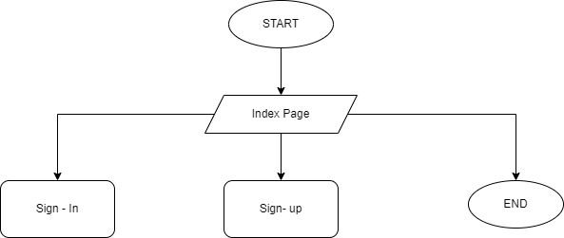
Index
1. Three options will be printed:-
a. Sign-In
b. Sign-Up
c. Exit
2. Then the input is taken from the user.
3. And according to the input given by the user the program will work.
4. As if the user enter the input as "3" the program will terminate.
User Input

Slide 9
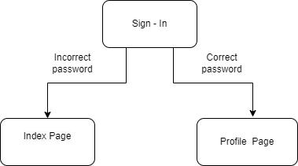

Sign-In
1. The program will ask for the student e-mail id and password.
2. If e-mail id and password is check with data present in the "user_database.csv".
3. If the email and password is correct ,then the user is logged in successfully and directed to the test screen otherwise the user will be directed to index page again with a message “Oops!! Incorrect Sign-In Details , Existing User [sign-in] New User [sign-up]”.
Correct Email Password
Profile Page
Incorrect Email Password
Sign-in or Sign -up

Slide 10
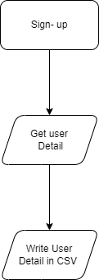
Sign-Up
1. The program will ask for the details of the student like username , password, email-id, mobile-number, date of birth and place of birth.
2. If all the details given by the student is correct.
3. Then all these details are inserted in "user_database.csv".
4. After this you will be directed to the index page.
Details

Slide 11
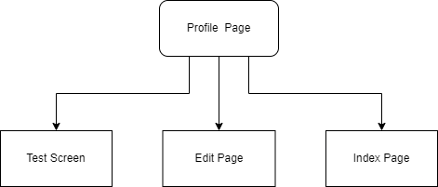
Profile Page
User Detail
In this, five message will be displayed on the user's screen to take the input from the user:
1. Name
2. E-mail
3. Mobile no.
4.DOB
5.Place
All the above details of the users will be printed. Then a pop-up message will be displayed on the user's screen to take the input from the user. For instance:
1.ENTER[T] TO TAKE THE TEST
2.ENTER[E] TO EDIT PROFILE
3.ENTER[L] TO LOGOUT
If the user enters the input “T” then he will be redirected to take test, If the user enters the input “E” then he will be redirected to edit profile page, If the user enters the input “L” then will be redirected to logout, If the user enters any other input, then will be redirected to profile page.

Slide 12
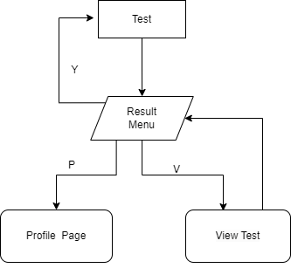
Test Screen
In the test screen, some instructions will be displayed on the user's screen before starting the test. After this, the user will be asked whether he wants to proceed further to take the test or not. If the input enters “Y” as the input, then the user will be redirected to the test screen to take the test. And if the user enters “N” as the input then the user will be redirected to the profile page.
If the user enters anything else other than yes or no, then a pop-up will appear on the user’s screen with a message “Invalid Input”.
INSTRUCTIONS

Slide 13


Test
In this online test platform, the user will be given 10 questions. Each question has a time limit of 30 seconds. If the user failed to attempt the question in the given time, then he will be directly transferred to another question and the user won’t be able to attempt that question that the user missed. And the above 10 questions will be randomly picked from a set of 20 questions provided in the question bank.
Questions
Bank
Questions

Slide 14

Test Result
1.In this, “RESULT” and “TOTAL SCORE” messages will be displayed on the user's screen.
2.Then a pop-up message will be displayed on the user's screen to take the input from the user,
For instance, if the user enter the input :
1. ENTER[Y] to retake the test
2. ENTER[P] to go to profile page
3. ENTER[V] to view the test
3.If the user enters the input “Y” then he will be redirected to retake test, If the user enters the input “p” then will be redirected to profile page, If the user enters the input “V” then will be redirected to view the test, If the user enters any other input, then “INVALID OPTION ” will be displayed.

Slide 15
View Test
In view test, the user will be able to evaluate the test. The question as well as the option selected by the user will be displayed on the screen along with the correct answer. By viewing the test, the user will be able to evaluate his marks as well as the topics in which the user is lacking.

Slide 16

Thank You
Github

